Slide 1

Plant Variety Registration and Licensing Agreements
AFSTA Congress Special Interest Groups Meeting
Date: 5th March 2019
Place: Mombasa, Kenya
Katrin Kuhlmann, President and Founder, New Markets Lab

Slide 2
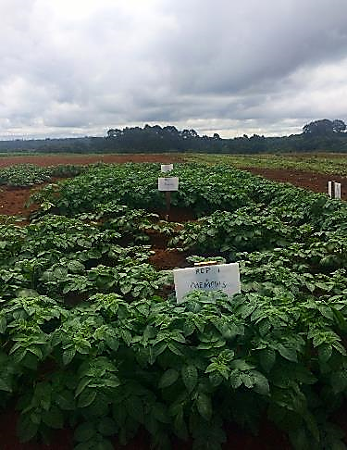
The New Markets Lab
Non-profit center for law and development that houses comparative expertise and an international team of lawyers focused on leveraging law and regulation as a tool for sustainable economic development and providing thought leadership and legal capacity in an evolving global market
House a innovative set of legal tools
  Benchmark national systems against international rules and good regulatory practices
  Highlight regulatory tradeoffs and options that will result in improvements in implementation
  Use scenario-based planning to customize reform efforts
NML works to build legal capacity through our legal tools, stakeholder consultations, ongoing partnerships, and scenario-based regulatory models
  Improve the design and implementation of economic laws and regulations,
  Address regulatory bottlenecks as they arise
  Support local efforts to strengthen the feedback loop between regulators and local communities

Slide 3

NML’s Partnership with SFSA Under Seeds2B
NML has a longstanding partnership with the Syngenta Foundation for Sustainable Agriculture (SFSA) and its Seeds2B project, which is designed to help farmers access quality, affordable seeds of improved varieties for the crops they need
Partnership focused on:
  Capacity Building: Increase awareness of regulatory aspects of seed systems among private sector actors, breeders, lawyers, and other stakeholders
  Case Studies: Assess the implementation of regional seed initiatives at the national level (countries covered include Ghana, Kenya, Nigeria, Zambia, and Zimbabwe)
  Test Cases: “Stress test” regional regulatory systems and determine how they work in practice
    NML and SFSA have facilitated regional registration of nearly 30 seed varieties across 7 crops in East Africa, COMESA, and SADC

Slide 4

NML-SFSA Collaboration Under PASTTA
The Partnership for Seed Technology Transfer in Africa (PASTTA), is a USAID funded partnership among Seeds2B, NML, and the African Agricultural Technology Foundation (AATF) that aims to enable the transfer of best-bet seed-based technologies
PASTTA addresses some of the main bottlenecks in the market to improve:
  Promotion and dissemination of new varieties, in particular those selected by the public sector
  Involvement of the seed private sector in multiplication, commercial development, and dissemination of seed varieties
  Demand for new varieties
  Harmonization of seed regulations

Slide 5




NML-SFSA Collaboration Under AVISA
The Accelerated Varietal Improvement and Seed Delivery of Legumes and Cereals in Africa (AVISA) project is funded by the Bill and Melinda Gates Foundation and involves several partners, including the International Crops Research Institute for the Semi-Arid Tropics (ICRISAT), the International Institute of Tropical Agriculture (IITA), International Center for Tropical Agriculture (CIAT), National Agricultural Research Organizations, and SFSA and NML
Project partners are working towards establishing a robust seed system that:
  Increases the quantity and quality of performance data substantiating varietal superiority;
  Boosts the availability of EGS seed by strengthening the technical and business acumen of the public EGS systems through technical, management and business capacity building;
  Establishes a clear path and handover process from the research system to the private sector; and
  Enables private sector multipliers to seize opportunities to capitalize on the commercialization of the targeted crops
NML and SFSA will contribute through:
  Practical regulatory interventions to improve implementation of harmonized rules
  Development of fair and equitable licensing models
  Hands-on learning modules to build regulatory capacity

Slide 6
Introduction & Background – Elements of Seed Regulatory Systems
Seed Variety Release and Regulation
  Most countries have a formal process for seed variety release and registration that includes testing for Distinctness, Uniformity, and Stability (DUS) and Value for Cultivation and Use (VCU) before new varieties can be released; number of seasons of testing varies by country and region
Seed Certification
  Most countries require that seed go through a formal process of certification before commercialization (seed must be formally released and registered before certification); also covered under regional rules (e.g. COMESA)
Seed Trade
  National and regional seed rules govern the importation and exportation of seed, including sanitary and phytosanitary (SPS) controls
Plant Variety Protection (PVP)
  Legal framework for ownership of varieties; underpins licensing and commercialization of seed
  Arusha Protocol includes provisions on compulsory, exclusive, and non-exclusive licensing of regional varieties

Slide 7
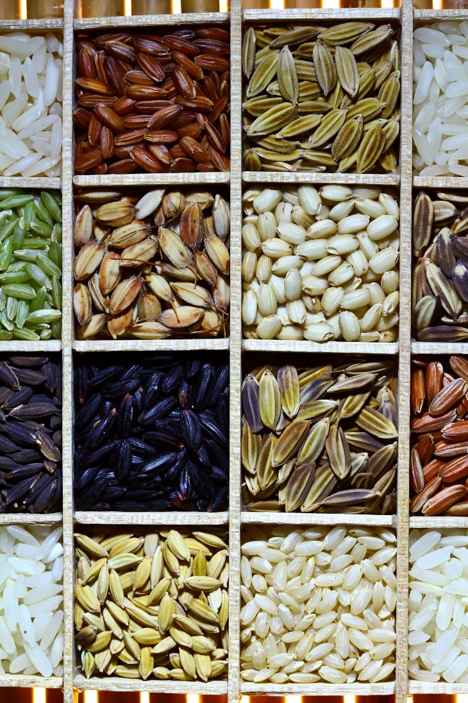
IP Licensing - Background
A licensing agreement is essentially a contract between two entities, or “parties”
Licensing allows for the transfer of technology from the inventor to the user, while still maintaining control of how the variety is used
Why enter into a licensing agreement?
      If you are a seed company…?
      If you are a research institute…?
This Photo by Unknown Author is licensed under CC BY-SA-NC

Slide 8

IP Licensing – Rationales
Transfer seed technology and increase opportunities for commercialization
Improve farmer access to diverse, high quality seed varieties
Allow variety owners the option to try new geographical markets with relatively low upfront risk
Provide possible source of funding for public research institutions
This Photo by Unknown Author is licensed under CC BY
This Photo by Unknown Author is licensed under CC BY-NC-ND

Slide 9
Contractual Considerations
The specific terms, or parts, of the licensing agreement depend upon the international, regional, and national legal frameworks of the relevant country
The legal/regulatory framework:
  Impacts the strategies the licensor/licensee chooses to protect the variety
  Governs should there be a dispute or breach of rights
Some countries in Africa follow a common law system and others a civil law system
Some common practices exist in both systems, like the need to agree upon and carefully defining terms contained in the contract; this kind of information should be reflected in a licensing agreement (typically in the introductory section)
However, there are key differences between the two systems is that in a civil law system defines a greater number of contractual terms by law (contracts are shorter as a result), while common law systems allow more freedom for the contracting parties to define their own terms

Slide 10
IP Licensing – Elements of a Licensing Agreement
Definitions (Parties, Terms, etc.)
License Type/Exclusivity
Territory/Scope
Compensation/Royalties
Termination and Dispute Resolution
Other Considerations
  Sublicensing
  Reporting
  Flexible Clauses
  Compulsory Licensing
This Photo by Unknown Author is licensed under CC BY-NC-ND

Slide 11
Elements of a Licensing Agreement - Exclusivity
Three Types of Licensing Agreements:
  Exclusive
    LICENSOR grants to the LICENSEE the exclusive and non‑transferable right to produce, market and sell seed of the following crop variety(ies) in [Insert Territory]
  Limited Exclusivity
    LICENSOR grants to the LICENSEE the exclusive and non-transferable right to produce, market, and sell seed of the following crop variety(ies) in [Insert Territory] for a period of [insert time limit].
  Non-Exclusive
    LICENSOR grants to the LICENSEE the non-exclusive and non‑transferable right to produce, market and sell seed of the following crop variety(ies) in [Insert Territory]. The licensor remains free to exploit the same IP and allow any number of other licensees to exploit the same.
Example: KALRO – Kisima Farms Case Study (non-exclusive license)

Slide 12


Case Study – KALRO and Kisima Farms
Agreement to license potato seeds in Kenya
  National research institute (KALRO) had been doing licensing agreements for years, but with no royalties
  Wanted to find a way to get its research out onto the market, while also increasing access to quality seed
  Seed company (Kisima) wanted to get the latest variety of seeds out to its customers
Takeaway: Well-designed licensing agreements can help public breeders and research institutions generate needed revenue through royalties, while expanding access to seed

Slide 13
Elements of a Licensing Agreement – Exclusivity Cont’d
Another element of exclusivity is defining the material to be licensed
Depends upon several factors and interests of both the licensor/licensee (experience, market viability, existing portfolios, and work with other breeders)
For seed, the material usually falls within three main categories:
  Single varieties
  Selected crops/species
  All varieties

Slide 14
Elements of a Licensing Agreement - Territory/Scope
Territory defines where the seed can be commercialized/sold
  “This License is granted for the territory of [location, region, etc.]”
Most often the territory will be a country, but it could also be a region
  Regional scope might be desirable in locations with well harmonized rules on PVP
Duration of the contract is also part of scope – how long will the licensing agreement last?
  Factors to consider: length of time it takes to negotiate, the type of crop covered, level of exclusivity
  Note: Longer contract terms may mean less flexibility to renegotiate royalty prices

Slide 15
Elements of a Licensing Agreement - Royalties
A royalty is the fee a licensee pays the licensor
  This can also include fees related to the use of licensed varieties
  Should be at an acceptable market rate to ensure both access and profitability
When and How royalties are paid should also be included:
  Exact method depends upon needs of particular parties
  Payment might specify a date, or it could be more flexible (e.g.: 6 months after the end of the financial year of licensee)
  BUT NOTE – National laws may have restrictions on when and how royalties can be paid (e.g.: for farm saved seed)

Slide 16
Elements of a Licensing Agreement – Royalties Cont’d
Royalties are typically done on a case-by-case basis, but there are some “models” or “formulas”
  Fixed royalty rate
  Royalties connected to seed price
  Minimum royalty rate
  Royalty intervals and sold quantities
  Multiplication acreage and end-point royalties
    Example: In the case study example (KALRO – Kisima Farms), there was a fixed royalty rate that was a percentage of the yearly seed sales

Slide 17
Elements of a Licensing Agreement - Termination
This part of the licensing agreement outlines what happens: 1) when the contract “naturally” terminates, and 2) if there are any events that would trigger termination (e.g.: a breach of contract)
  Example: The KARLO-Kisima Farm case study contains both types of provisions
How to renew the contract should also appear here (upon mutual agreement by the parties, automatic renewal, or other)
Additionally, the agreement should include a provision on the process for resolving any dispute should there be a breach of contract. This should include:
  The governing law/jurisdiction
    Example: This agreement shall be subject to the laws of Kenya.
  The method for resolving disputes
    Will there be arbitration?
    A set period of mediation?
    Will the parties use the local court system of the governing legal system?

Slide 18
Elements of a Licensing Agreement - Other Considerations
Sublicensing occurs when the original breeder has licensed out its seed but then the licensee wants to transfer that right to another company
  Example: an original exclusive right with granting of a “right of first refusal” to license
Reporting to Licensor is a way for the licensor to check in on the progress for commercialization
“Use it or lose it” clauses make sure that the variety licensed is marketed by the licensee
Policy Notes
  Smallholder friendly clauses:
    Waiver of rights to collect smallholder licensing fees
    Agreement to make a majority percentage of the seed produced available to third parties
    Agreement to establish smaller seed pack sizes
  Gender - How to ensure that seed is made available to women growers?

Slide 19
Elements of a licensing agreement – Compulsory Licensing
Under certain circumstances including public interest (enumerated in PVP laws), government authorities may grant a compulsory license for an entity other than the IP holder
  These are non-assignable and non-exclusive
  Except in cases of national emergency, the proposed licensee must have made efforts to obtain the license voluntarily under reasonable commercial terms
  The rights holder must receive equitable remuneration
A compulsory license is traditionally perceived, under certain conditions, to counterbalance the exclusive rights of the IP rights holder, but it could also be a way of ensuring farmers’ access to new, important, and improved varieties
The scope and duration of the license will be limited to the public interest reasons for which it was authorized

Slide 20

Questions to Consider
What kind of licensing model best suits the needs of the parties?
What are your “must have” provisions?
What kind of crops would you license based on demand and need in the market/territory?
How would you address the main contractual elements:
  Exclusivity
  Territory/Scope
  Royalties
  Terminating the Agreement
Evaluate your sample contract for its sensitivity to some of the policy considerations, e.g. gender, smallholder farmers (for example, would you waive the right to collect smallholder licensing fees? Adjust packaging size?)
How would you propose to resolve potential disputes?
This Photo by Unknown Author is licensed under CC BY

Slide 21
Contact Us
Katrin Kuhlmann, President and Founder, New Markets Lab (kkuhlmann@newmarketslab.org)
  Senior Legal Fellow in East Africa Adron Nalinya Naggayi at analinya@newmarketslab.org
For additional information, please email us at mail@newmarketslab.org or visit our website at www.newmarketslab.org

