Slide 1

OVERVIEW OF THE SEED SECTOR & STATUS OF THE NATIONAL SEED TRADE ASSOCIATION OF GHANA
A NASTAG PRESENTATION
@
Ghana Seed Sector Stakeholders’ Workshop
Fiesta Royal Hotel, Accra
30th May 2019
Organized by
TASAI in collaboration with MoFA & NASTAG

Slide 2

OUTLINE OF THE PRESENTATION
INTRODUCTION
OVERVIEW OF THE SEED SECTOR & STATUS OF NASTAG
  Background to the Seed Sector
  Advances / Progress so far
  Challenges
  Perspectives / the Way Forward
CONCLUSION

Slide 3
INTRODUCTION
The National Seed Trade Association of Ghana (NASTAG):
an umbrella association of seed enterprises and companies (i.e. value chain actors within the seed industry).
legally registered on 1st February 2016 as a private entity under the Companies Act 1963, ACT 179 of Ghana.
Current membership stands at 41 seed enterprises (mostly private sector) from all over Ghana.

Slide 4
INTRODUCTION …/2
NASTAG is dedicated to supporting the competitiveness of Ghana’s seed value chain through:
  Business & technical capacity building of its members;
  Promotion of effective collaboration among and between actors in the chain;
  Advocacy, regulation and standardization; and
  Provision of general seed information

Slide 5
VISION AND MISSION
OUR VISION
Be the apex organization for promoting the growth of the seed industry through the improvement of members’ businesses and the use of quality seed for improved livelihoods in Ghana”
OUR MISSION
“To fulfill the interest of members through strong advocacy programmes and capacity building in Technical & Business Development skills and ethics, to advance the seed industry in Ghana”

Slide 6
OUR CORE VALUES
We strive to:
  Ensure equal recognition of all members, all of whom provide us with direction;
  Encourage consensus-driven decision-making;
  Promote member participation and prioritization of common issues;
  Pursue alliances with other similar groups that can contribute to our objectives;
  Ensure the highest level of ethics and transparency accompany all of our activities.

Slide 7
OUR GOALS
Enhance NASTAG’s exposure and recognition
Develop sources of funding to sustain NASTAG
Serve as the channel for the provision of improved seeds
Enhance seed marketing to reach all farmers, increasing yields and improving livelihoods
Advocate for and contribute to an efficient and evidence-based agricultural legal environment
Contribute to secure funding for National Seed Plan Implementation

Slide 8
OVERVIEW OF THE SEED SECTOR & THE ROLE/STATUS OF NASTAG:
  Brief Background to the Sector
  Advances / Progress so far
  Challenges
  Perspectives / the Way Forward

Slide 9
BRIEF BACKGROUND TO THE SECTOR
Quality seeds are a prerequisite to Productive and Profitability agriculture and constitute a major pathway for the achievement of national food security goals.
In Ghana’s agricultural development efforts, Quality Seed is one of the basic inputs for increasing agricultural productivity and achieving food self-sufficiency.
Currently, due to the dominance of small-scale holders, the use of quality seed is very much limited with only averagely 14% of farmers using certified seeds.

Slide 10
SEED SECTOR (2)
Factors of Low Utilization of Quality Seeds …
Commercialization of the seed sector (private sector-led) until recently did not receive the attention and support.
The National Policy to drive the seed sector development has not been sufficiently enforced.

Slide 11
SEED SECTOR (3)
The underlying factors of Low Utilization of Quality Seed includes:
Insufficient Production & Distribution of quality seeds with just approximately 20% of Certified Seed Requirements for major food crops produced annually
Crop | Total National Certified Seed RQM (MT) | Certified Seed Production (MT) | Percent Shortfall
Maize | 22500 | 4454.4 | (80.20%)
Rice | 16000 | 1396.3 | (91.27%)
Sorghum | 1500 | 4.2 | (99.72%)
Soya Bean | 3200 | 913.4 | (71.46%)
Cowpea | 3600 | 105.7 | (97.06%)
Groundnut | 40000 | 69.0 | (99.83%)
For Example:
Current Certified Seed Production as against National Demand in 2017

Slide 12
ADVANCES / PROGRESS SO FAR
NASTAG’s efforts since its inception have been geared towards improving production capacities (both in quantity & quality) and marketing of seeds as private seed sector players.
To establish the structures to effectively work towards achieving the above, some projects supported NASTAG, namely the:
  West African Seed Programme (WASP) of CoRAF
  USAID Feed the Future Ghana Agriculture Policy Support Project (APSP)
  USAID Feed the Future Ghana Agricultural Technology Transfer (ATT) Project
Based on which the following have been accomplished:

Slide 13
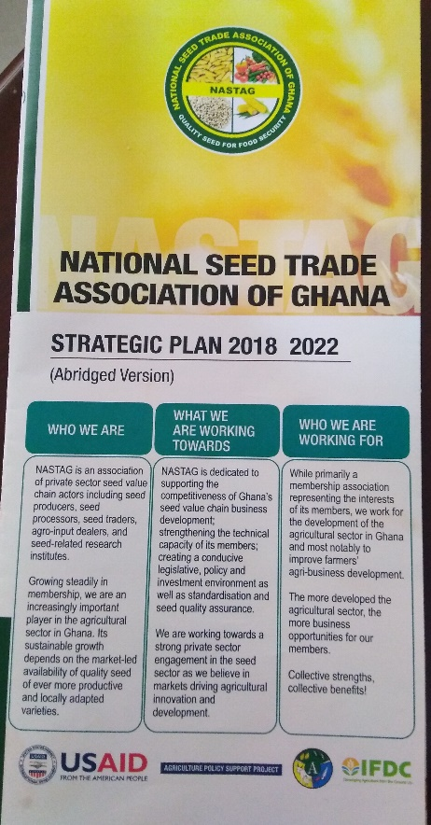
ADVANCES / PROGRESS SO FAR (2)
Developed 5-year Strategic Plan that is guiding the Association in developing Annual Work Plan to meet the demands of the seed sector and its members
Trained Twenty (20) of its members in Seed Enterprise Quality Management; helping them to professionally manage their seed businesses to produce high quality seeds to internationally accepted standards.
Through collaboration with MoFA, eight NASTAG members benefitted from Quality Rice Foundation Seed Production Training facilitated by the International Rice Research Institute(IRRI).

Slide 14
ADVANCES / PROGRESS SO FAR (3)
NASTAG coordinated the supply of certified seeds under the government flagship Planting for Food and Jobs (PFJ) for its members for 2017 and 2018:
  N/A (not applicable) means no contract was awarded to supply
  NB: Though SeedPAG National is a member of NASTAG, figures here do not include direct supplies by some regional SeedPAG for 2018
NASTAG is currently supplying seeds to the 2019 PFJ under a Contract supply of over 1000MT seeds: 720 OPV Maize , 280MT AGRA & Jasmin Rice & 3MT Vegetables (Tomatoes, Onions & Cucumber)
 | 2017 (MT) |  |  | 2018 (MT)
 | Rice | Maize (OPV) | Maize (Hybrid) | Rice | Maize (OPV) | Maize (Hybrid)
Members Supply through the Association | N/A | 640 | N/A | 50 | 536 | N/A

Slide 15
ADVANCES / PROGRESS SO FAR (4)
To connect easily and learn from other advanced Associations, NASTAG registered its membership with the African Seed Trade Association (AFSTA) and was thus represented at the 2017, 2018 and 2019 Annual Congress in Senegal, Egypt and Kenya respectively.
Through networking at this event NASTAG has become the first port of call for those desiring to enter the seed industry in Ghana for guidance where applicable to the appropriate institutions. Some are currently establishing grounds in Ghana through this initiative namely:
    The African Seed Company ( SEEDCO)
    S3A Development Project of CRS
    World Vegetable Centre
    Petkus Technologies
    MAS seeds

Slide 16
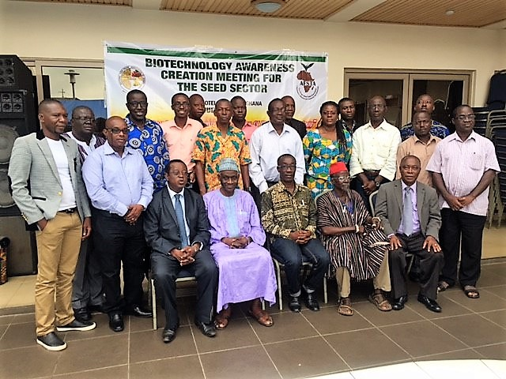
ADVANCES / PROGRESS SO FAR (5)
In collaboration with AFSTA, there has been increased awareness on Biotechnology.
  Three (3) sensitization sessions held since the establishment of NASTAG.
  Members and other value chain actors are getting more informed, allowing them to understand the concept and progress on Bt from the African perspective.

Slide 17

ADVANCES / PROGRESS SO FAR (6)
NASTAG has developed and launched the Seed Companies and Seed Producers Directory in Ghana; a first step in cleaning the sector by eliminating fake seed producers and also enhancing business networking and partnership.
The 1st edition (2019) included the National Catalogue for Plant Species & Varieties approved by the National Seed Council; this will increase accessibility to updated information as a quick reference document.
Cover page of the 2019 Seed Directory

Slide 18

ADVANCES / PROGRESS SO FAR (7)
NASTAG facilitated the first ever National Seed Business Networking Forum, May 23-24, 2018 in Accra that brought over 100 relevant seed sector players together:
  Chaired by Mr. Josiah Wobil, the Chairman of the National Seed Council (NSC);
  It deliberated on issues relating to the seed sector; and
  A communique emerged that was presented officially to the Hon. Minister of Food and Agriculture.
From the 2018 Forum Communique:
  Discussion with the NSC, MoFA and some development partners has progressed on the urgent need to develop National Seed Demand Forecast to project the seed needs of the country.
  To enhance farmer confidence in certified seeds produced locally, NASTAG is considering instituting a self-regulatory mechanism possibly using a coding system to effectively track all seeds supplied by its members, etc.
This Forum is being institutionalized as an annual seed sector Event to deliberate on Challenges and opportunities: the 2nd Edition is slated for September 2019.

Slide 19
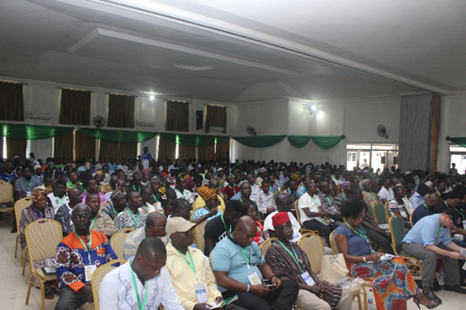
ADVANCES / PROGRESS SO FAR (8)
NASTAG has hosted two Annual Northern Ghana Pre-season Planning and Networking events in Tamale, for agricultural value chain actors to network, showcase their products and farm inputs, and strike business deals.
The 2019 Preseason Agribusiness Networking & Exhibition Event , held on April 4, 2019, was organized by NASTAG and partners, without direct donor funding for the first time.

Slide 20
Challenges
Currently, the seed sector in Ghana is saddled with challenges, and key among them are:
  a) Inadequate development & commercialization of quality seeds;
  b) Inadequate seed market & industry data / information;
  c) Non-existence of seed market intelligence and demand forecasting system, affecting seed production and marketing;
  d) Inadequate access to improved early generation (i.e. foundation / hybrid) seeds;
  e) Difficulties in the production and marketing of quality foundation and certified seeds;

Slide 21
Challenges (2)
    f) Weak operational, technical and business capacity of the seed SMEs to produce quality seeds,
    g) Lack of sustainable funding for the private sector organization (NASTAG) to engage the public sector,
    h) Enabling legal and policy environment for seed business not fully functional,
    i) Very low participation of women and the youth in seed SMEs,
    j) Over-dependency on open pollinated varieties (OPVs)
    k) Limited capacity on hybrid seed production and its limited availability

Slide 22
Perspectives / the Way Forward
Institutional Strengthening of the Private Seed Sector under NASTAG
Focus on the strategic direction as stipulated in the NASTAG 5-year plan:
  Service to members (business facilitation & capacity building);
  Advocacy for conductive legislative and policy environment as a recognized industry player;
  Knowledge-sharing internally and externally; and
  Organization capacity strengthening and sustainability.
Increase partnerships and specialization along the seed value chain:
  Support engagement between large seed companies and smaller ones in SEEDPAG
  Encouraging NASTAG members who qualify under the certification rules to go into Foundation Seed production following the requisite Certification Procedures (start by focusing on just about four private seed companies that are interested.
  NASTAG collaborating with RMG, SEEDCO and the relevant CSIR Institutes and Universities to produce Foundation Seeds of their released varieties. (to get the NARIs to focus more on breeder seed production thus enhancing the quality of the already existing varieties.
  Conduct training in Hybrid Seed Production (which has started in collaboration with FAO; it will be 3 phases for 17 participants with the first 3-day training held in April 2019).

Slide 23
Perspectives (2)
Aside the constituted Executive Council, NASTAG has put in place three sub-committees namely the:
  Technical Standards;
  Business Development and Ethics; and
  Advocacy and Communication committees.
    These committees see to respective issues of concern to the Association. They report back to the Executive Council for further action and recommendations where applicable.
    Some of the feedbacks are carried onto the National Seed Council meetings and further to MoFA for attention and consideration for expedite action.

Slide 24
Perspectives (3)
Seed sector policy & regulation for improved enabling environment
Engage and work collaboratively with government and other industry development partners for:
  Operationalization of the Seed & Fertilizer Fund (as enshrined in the Seed Law) to the benefit of the private sector industry players;
  Passage of the Plant Breeders Rights’ Bill in Parliament into Law; and
  Leverage on the government initiative (such as PFJ Campaign) to rapidly develop the seed sector and sustain farmers’ uptake of quality certified seed.

Slide 25
Perspectives (4)
Improving seed quality for increased agricultural productivity
To improve seed quality and particularly stamp out fake seeds, NASTAG:
  Develops the seed companies and enterprise directory as the first step to weed out unauthorized / uncertified seed dealers; the 2019 edition is out.
  Will fully cooperate in the seed certification processes.
  Sensitizes members to enhance their internal seed quality monitoring as well as participate in license certification
  Seeks support to equip its members with basic moisture meters, germination apparatus and other equipment that will eventually make certification less expensive; currently facilitating acquisition of equipment for members at AESD/MoFA.
  Seeks to support and encourage members to carry out field demonstrations and sensitization of farmers within their operational areas.

Slide 26
CONCLUSION
Development of the seed sector to carry out efficient production and marketing of quality certified seeds by the private sector is effectively realizable under a strengthened sector organization like NASTAG.
NASTAG will continue to play a lead role in institutionalizing public-private dialogue in improving the enabling environment for enhanced private sector participation and seed industry growth.
So, these efforts should be supported by all seed sector stakeholders to enable us develop a competitive industry, capable of ensuring the sustainable production, availability, accessibility and affordability of quality seeds.

Slide 27
THANK YOU

